Slide 1
Template
Strategic Planning Session
Updated July 2019

Slide 2
Current Programs List all programs, grants, i.e. BIA ICWA, etc

Slide 3
Vision – Where we want to be in 100 years A vision is a long term goal

Slide 4
Core Values What are the values that we operate our work with? i.e., employ our own Tribal members, non-punitive consequences

Slide 5
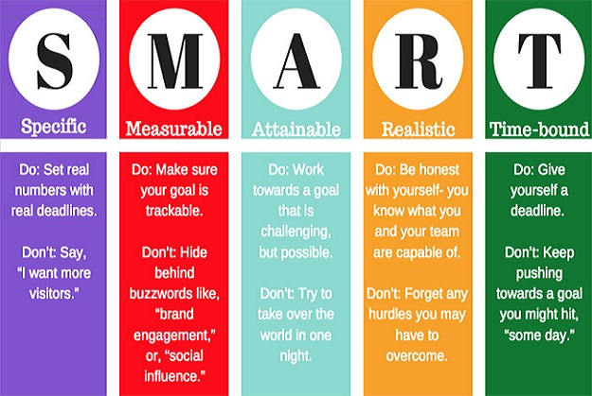

Slide 6
5 Year Goals What do we want our Tribal Justice System to look like in 5 years?

Slide 7
Strengths What are we good at, what do we have, what is politically, culturally, environmentally on our side?

Slide 8
Weaknesses What can we improve on, grow, need to work on?

Slide 9
Opportunities What can we potentially do, improve, get better at, obtain?

Slide 10
Threats What could delay, stop, impact our work?

Slide 11
Yearly Goals What steps do we need to take to get to our 5 year goals?

Slide 12
Measuring our Success How do we know we have accomplished our goals?

Slide 13
Staffing Organization Show your employees and departments
Council
Tribal Administrator
Accounting
Maintenance
ICWA Worker
IGAP Coordinator
Grant Writer
Notes:
This is what our current structure looks like

Slide 14
The Final Plan
There are many forms of strategic plans, in my experience a one page strategic action plan is very useful and easy to reference. A larger plan is useful for grant funders. Every plan is unique to your organization.

Slide 15
Any Questions?
Written by Adrianne Christensen July 2019
If you would like facilitation, help, have any questions at all, please contact me!
adriannec@portheidenalaska.com
907-947-0985 call or text!

